Slide 1
Session 1

Slide 2
Daily
Que hice ayer
Que hare hoy
Que me detiene

Slide 3
Compiled vs interpreted code
Every program is a set of instructions, whether it’s to add two numbers or send a request over the internet. Compilers and interpreters take human-readable code and convert it to computer-readable machine code.
Compiled Languages
Compiled languages are converted directly into machine code that the processor can execute. As a result, they tend to be faster and more efficient to execute than interpreted languages
Interpreted Languages
Interpreters run through a program line by line and execute each command. Interpreted languages were once significantly slower than compiled languages.
Just in Time Languages
Just-In-Time compilation, or JIT, is a technique used by runtime interpreters for languages like JavaScript, C#, and Java to bring execution speeds closer to the native performance offered by precompiled binary languages like C++

Slide 4
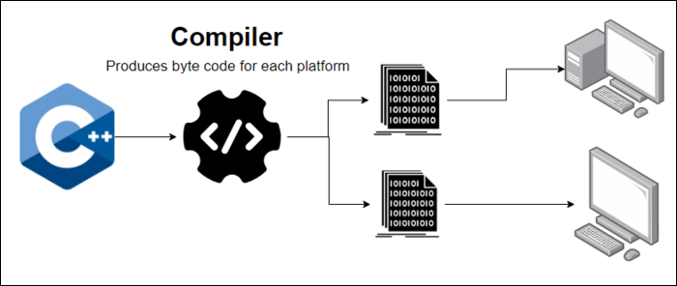
Compiled

Slide 5
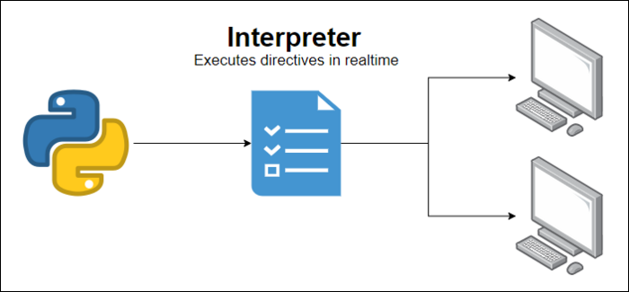
Interpreted

Slide 6
Just in time
Just-In-Time compilation is essentially a compiler that procrastinates, and only compiles the code for each function whenever it is needed. Whenever you call a function, if the JIT compiler hasn’t seen it yet, it will compile that function (applying any optimizations for the machine it’s running on), and run it. The next time you call the function, it already has the machine code on hand, so it just needs to look it up from the cache.
Just-In-Time refers to the fact that the interpreter doesn’t have to compile the whole app all at once. It certainly could, but for a large app it would lead to very high startup times. It’s better for performance to only do compilation when it’s needed (i.e., just in time).

Slide 7
Basic C#
Creating a console application in .net core
Dotnet new console
Static void Main ()
{
Console.WriteLine (“Hello”);
Console.WriteLine (“Goodbye”);
}

Slide 8
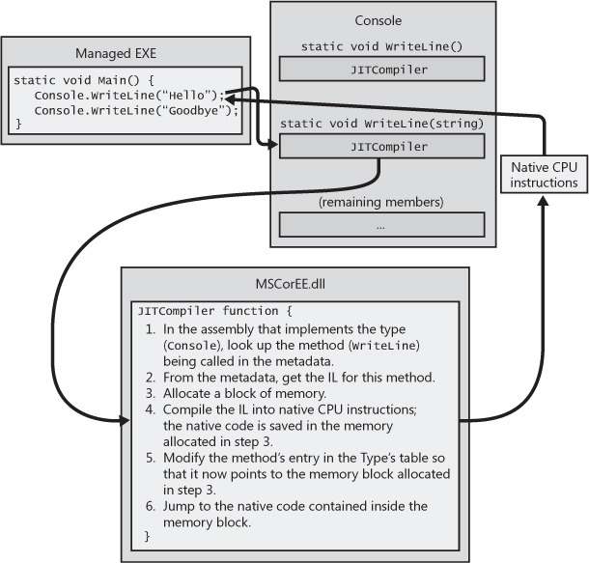
CLR in action

Slide 9
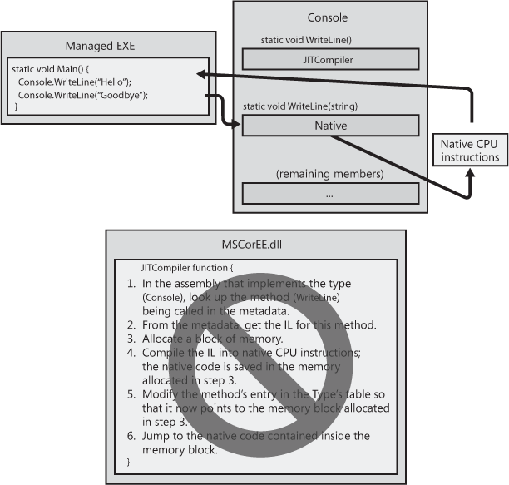
CLR in action 2

Slide 10
Exercises
Write a C# program to get the absolute value of the difference between two given numbers. Return double the absolute value of the difference if the first number is greater than second number.
Write a C# program to print the odd numbers from 1 to 99. Prints one number per line.

